Slide 1
Network Applications: Application Overlay Networks
Y. Richard Yang
http://zoo.cs.yale.edu/classes/cs433/
10/17/2017

Slide 2
Outline
Admin and recap
Application overlays (distributed network applications) to
scale bandwidth/resource (BitTorrent)
distribute content lookup (Freenet, DHT, Chord)
distribute content verification (Block chain) [optional]
achieve anonymity (Tor) [optional]

Slide 3
Admin
Assignment three status and questions?
Exam 1: Tuesday next week, cover from lecture 1 to today’s lecture

Slide 4
Recap: Direction Mechanisms
App
DNS name1
DNS name2
- cname
- hierarchy
IP1
IP2
IPn
Cluster1 in US East
Cluster2
in US West
Cluster2
in Europe
Smart switch/LB - NAT rewrite - Direct reply - NLB
Load
balancer
Proxy as a mechanism for replica content consistency
Load
balancer
proxy
servers

Slide 5
Recap: Scalability of Server-Only Approaches
origin
Direction Mechanism
edge servers
C₀= sum of server bandwidth
client 1
per client = C₀/n
client 2
client n
client 3

Slide 6
Recap: Scalability of Server-Client System (P2P)
Maximum per client throughput
R = min{C₀, (C₀+ΣC_{i})/n}
The bound is theoretically approachable, but need to address practical problems
Churns
Incentive
Distributed optimization
server
C₀
C₁
client 1
C_{n}
C₂
C₃
client n
client 2
client 3

Slide 7

Recap: BitTorrent
Key ideas
Swarming (gossiping)
divide jobs into smaller pieces and exchanged among peers
Content scheduling: Request rarest blocks
maximize content availability
Bandwidth scheduling: Tit-for-tat unchoke + opportunistic unchoke
exploration + exploitation (a type of learning system)
also a type of incentive mechanism
1.interested/ 3. request
2. unchoke/ 4. piece

Slide 8
BitTorrent Fluid Analysis
Normalize file size to 1
x(t): number of downloaders (also known as leechers) who do not have all pieces at time t.
y(t): number of seeds in the system at time t.
λ: the arrival rate of new requests.
μ: the uploading bandwidth of a given peer.
c: the downloading bandwidth of a given peer, assume c ≥ μ.
θ: the rate at which downloaders abort download.
γ: the rate at which seeds leave the system.
η: indicates the effectiveness of downloader sharing, η takes values in [0, 1].

Slide 9
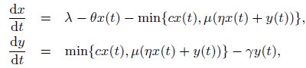
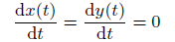
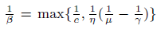
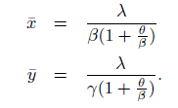
System Evolution
Solving steady state:
Define

Slide 10
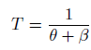
System State
Q: How long does each downloader stay as a downloader?
λ
Key take-away: not scaling inverse with system size (x)

Slide 11
Outline
Admin and recap
Application overlays (distributed network applications) to
scale bandwidth/resource (BitTorrent)
distribute content lookup (Freenet, DHT, Chord)

Slide 12

The Content Lookup Problem
N₂
N₁
N₃
Key=“title”
Value=MP3 data…
Internet
?
Client
Publisher
Lookup(“title”)
N₄
N₆
N₅
find where a particular file/content is located
Notes:
1000s of nodes.
Set of nodes may change…

Slide 13
Discussion
How do we solve the content lookup problem now?
What are some general potential approaches for the content lookup problem?

Slide 14
Outline
Admin and recap
Application overlays (distributed network applications) to
scale bandwidth/resource (BitTorrent)
distribute content lookup (Freenet, DHT)
distributed flooding

Slide 15
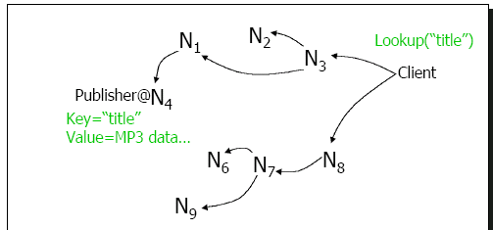
Decentralized Flooding
On startup
client contacts other servents (server + client) in network to form interconnection/peering relationships
Upon receiving a lookup request
send requests to neighbors
neighbors recursively forward the requests

Slide 16
Decentralized Flooding
C
E
F
B
D
M
L
J
A
G
H
S
K
I
N

Slide 17
Decentralized Flooding
send query to neighbors
C
E
F
B
D
M
L
J
A
G
H
S
K
I
N
Each node forwards the query to its neighbors other than the one who forwards it the query

Slide 18
Background: Decentralized Flooding
C
E
F
B
D
M
L
J
A
G
H
S
K
I
N
Each node should keep track of forwarding state to avoid loop !
node state: nodes keep state (which will time out---soft state)
packet state: carry the state in the query, i.e. carry a list of visited nodes

Slide 19
Decentralized Flooding Example: Gnutella
Basic message header
Unique ID, TTL, Hops
Message types
Ping – probes network for other servents
Pong – response to ping, contains IP addr, # of files, etc.
Query – search criteria + speed requirement of servent
QueryHit – successful response to Query, contains addr + port to transfer from, speed of servent, etc.
Ping, Query are flooded
QueryHit, Pong: reverse path of previous message

Slide 20
Advantages and Disadvantages of Decentralized Flooding
Advantages:
totally decentralized, highly robust
Disadvantages:
not scalable; the entire network can be swamped with flood requests
to alleviate this problem, each request has a TTL to limit the scope
each query has an initial TTL, and each node forwarding it reduces it by one; if TTL reaches 0, the query is dropped (consequence?)

Slide 21
Outline
Admin and recap
Application overlays (distributed network applications) to
scale bandwidth/resource (BitTorrent)
distribute content lookup (Freenet, DHT)
distributed flooding
distributed routing search

Slide 22
Example: Freenet
History
final year project Ian Clarke , Edinburgh University, Scotland, June, 1999
Goals:
totally distributed system without using centralized index or flooding, instead search by routing
routing/storing system responds adaptively to usage patterns, transparently moving, replicating files as necessary to provide efficient service
provide publisher anonymity, security
free speech : resistant to attacks – a third party shouldn’t be able to deny (e.g., deleting) the access to a particular file (data item, object)

Slide 23
Basic Structure of Freenet
Each machine stores a set of files; each file is identified by a unique identifier (called key or id)
Each node maintains a “routing table”
id – file id, key
next_hop node – where to search for a file with id’ that is similar to id
file – local copy, if exists, of file with id
id next_hop file
…
…
…

Slide 24
Freenet Query
id next_hop file
…
API: file = query(id);
Upon receiving a query for file id
check whether the queried file is stored locally
check TTL to limit the search scope
each query is associated a TTL that is decremented each time the query message is forwarded
when TTL=1, the query is forwarded with a probability
TTL can be initiated to a random value (why random value?)
look for the “closest” id in the table with an unvisited next_hop node
if found one, forward the query to the corresponding next_hop
otherwise, backtrack
ends up performing a Depth First Search (DFS)-like traversal
search direction ordered by closeness to target
When file is returned it is cached along the reverse path (any advantage?)
…
…
Notes:
[09/22/2009] Programming assignment 0 is linked on schedule.

Slide 25
Query Example
query(10)
n1
n2
4 n1 f4
12 n2 f12
5 n3
1
9 n3 f9
4’
4
n4
n5
2
14 n5 f14
13 n2 f13
3 n6
5
4 n1 f4
10 n5 f10
8 n6
n3
3
3 n1 f3
14 n4 f14
5 n3
Beside the routing table, each node also maintains a query table containing the state of all outstanding queries that have traversed it → to backtrack

Slide 26
Insert
API: insert(id, file);
Two steps
first attempt a “search” for the file to be inserted
if found, report collision
if not found, insert the file by sending it along the query path (why?)
a node probabilistically replaces the originator with itself (why?)
Notes:
thus inserted files are placed on nodes already possessing files with similar keys

Slide 27
Insert Example
Assume query returned failure along the shown path (backtrack slightly complicates things); insert f10
insert(10, f10)
n1
n2
4 n1 f4
12 n2 f12
5 n3
9 n3 f9
n4
n5
14 n5 f14
13 n2 f13
3 n6
4 n1 f4
11 n5 f11
8 n6
n3
3 n1 f3
14 n4 f14
5 n3

Slide 28
Insert Example
insert(10, f10)
n1
n2
10 n1 f10
4 n1 f4
12 n2
orig=n1
9 n3 f9
n4
n5
14 n5 f14
13 n2 f13
3 n6
4 n1 f4
11 n5 f11
8 n6
n3
3 n1 f3
14 n4 f14
5 n3

Slide 29
Insert Example
insert(10, f10)
n1
n2
10 n1 f10
4 n1 f4
12 n2
10 n1 f10
9 n3 f9
n4
n5
14 n5 f14
13 n2 f13
3 n6
4 n1 f4
11 n5 f11
8 n6
n3
3 n1 f3
14 n4 f14
5 n3

Slide 30
Insert Example
n2 replaces the originator (n1) with itself
insert(10, f10)
n1
n2
10 n1 f10
4 n1 f4
12 n2
10 n1 f10
9 n3 f9
n4
n5
orig=n2
14 n5 f14
13 n2 f13
3 n6
4 n1 f4
11 n5 f11
8 n6
n3
3 n1 f3
14 n4 f14
5 n3

Slide 31
Insert Example
insert(10, f10)
n1
n2
10 n1 f10
4 n1 f4
12 n2
10 n1 f10
9 n3 f9
n4
n5
orig=n2
14 n5 f14
13 n2 f13
3 n6
4 n1 f4
11 n5 f11
8 n6
n3
10 n2 10
3 n1 f3
14 n4

Slide 32
Insert Example
Insert(10, f10)
n1
n2
10 n1 f10
4 n1 f4
12 n2
10 n1 f10
9 n3 f9
n4
n5
10 n2 f10
14 n5 f14
13 n2
10 n4 f10
4 n1 f4
11 n5
n3
10 n2 10
3 n1 f3
14 n4

Slide 33
Analysis: Freenet Dynamics
As nodes process queries, connectivity increases
nodes will discover other nodes in the network
Nodes eventually specialize in locating similar keys
if a node is listed in a routing table, it will get queries for related keys
thus will gain “experience” answering those queries
caveat: lexigraphic closeness of file names/keys may not imply content similarity
Popular data will be transparently replicated and will exist closer to requestors

Slide 34
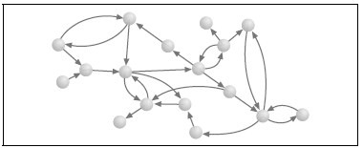
Understanding Freenet Self-Organization: Freenet Graph
id next_hop file
…
…
We create a Freenet reference graph
creating a vertex for each Freenet node
adding a directed link from A to B if A refers to an item stored at B

Slide 35
Experiment: Freenet Graph: Init
id next_hop file
…
…
i-2
i-1
i
i+1
i+2
Assume a network of 1000 nodes, with node id 0 to 999
Each node can store 50 data items, and 200 references
Assume initially each node i has i, and knows the storage of i – 2, -1, i + 1, i + 2 (all mod 1000)
thus a regular, locally-clustered graph with avg path length
~ 1000 / 8 = 125

Slide 36
Example: Search Effect
id next_hop file
…
…
i-2
i-1
i
i+1
i+2
What is the effect that the first search is node 0 searching for item 490 (assume no probabilistic replacement to hide origin)?
Nodes 0, 2, 4, 6, …, 488 all cache item 490, and has a pointer to node 490
The search forms many long-distance links

Slide 37
Experiment: Evolution of Freenet Graph
At each step
pick a node randomly
flip a coin to determine search or insert
if search, randomly pick a key in the network
if insert, pick a random key
Evolution of path length and clustering;
Clustering is defined as percentage of local links

Slide 38
Freenet Evolves to Small-World Network
With usage, the regular, highly localized Freenet network evolved into one irregular graph
Highly-connected nodes provide shortcuts/bridges
make the world a “small world”
most queries only traverse a small number of hops to find the file

Slide 39
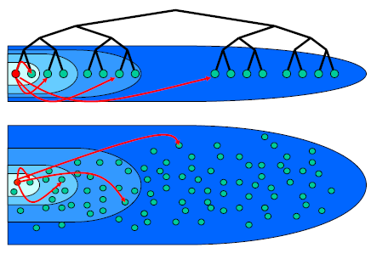
Small-World
First discovered by Milgrom
in 1967, Milgram mailed 160 letters to a set of randomly chosen people in Omaha, Nebraska
goal: pass the letters to a given person in Boston
each person can only pass the letter to an intermediary known on a first-name basis
pick the person who may make the best progress
result: 42 letters made it through !
median intermediaries was 5.5---thus six degree of separation
a potential explanation: highly connected people with non-local links in mostly locally connected communities improve search performance !

Slide 40
Freenet: Summary
Advantages
Many interesting design features
Issues
Does not always guarantee that a file is found, even if the file is in the network
Good average-case performance, but a potentially long search path in a large network

Slide 41
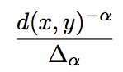
Analysis: Effective, Distributed Routing Search
Question: what kind of long distance links to maintain so that distributed content routing search is effective?
Assume that each node has
a fixed # (say p distance away) local links
a small # (say a total of q) long-distance links s.t. the probability of a link between nodes x and y is some (α) inverse-power of the distance d(x, y) of x and y
Different alpha’s give diff types of links.
Objective: what is a good alpha?

Slide 42
What Should the Long-Distance Links Look?
Consider the simple case of one dimensional space.
Which alpha leads to best performing distributed search alg?
0
1
2
2
n

Slide 43
What Should the Long-Distance Links Look?
For 1-d space, for any distributed algorithm, the expected # of search steps, for different α’s:
0 ≤α < 1 : ≥ k₁n^{(1-α)/2}
α > 1 : ≥ k₁n^{(α-1)/α}
α = 1 : O(log²n) greedy search

Slide 44
Effective, Distributed Routing Search Guideline
In the general case, α should be the dimension
Implication: a guideline on long-distance links: roughly the same number of nodes in each region A1, A2, A4, A8, where A1 is the set of nodes who are one lattice step away, A2 is those two steps away, A4 is four steps away…
probability is proportional to (lattice steps)^{-d}

Slide 45
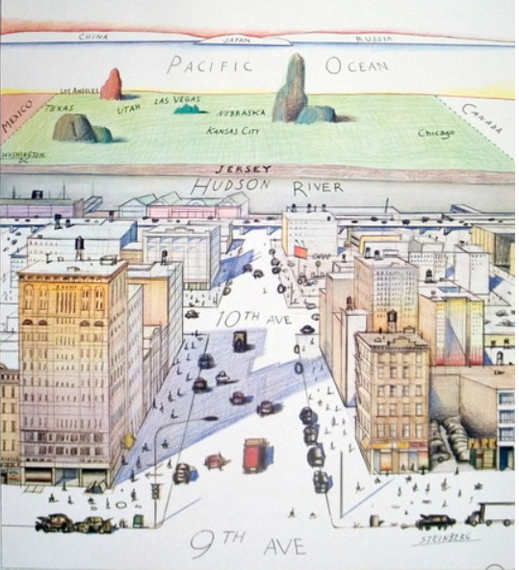
Warped World
Saul Steinberg; View of World from 9th Ave

Slide 46
Outline
Admin and recap
Application overlays (distributed network applications) to
scale bandwidth/resource (BitTorrent)
distribute content lookup (Freenet, DHT)
distributed flooding
distributed routing search
freenet
effective, distributed routing search guideline
distributed hash table (DHT)

Slide 47
DHT: Overview
Abstraction: a distributed “hash-table” (DHT) data structure for distributed, routed, content search
put(key, value) and get(key) → value
DHT imposes no structure/meaning on keys
Distributed application
put(key, data)
get (key)
DHT
node
node
….
node

Slide 48
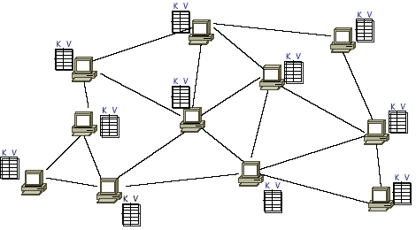
DHT: API

Slide 49
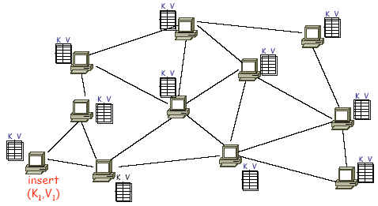
DHT: API (2)

Slide 50
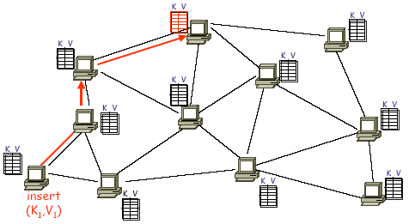
DHT: API (3)
Greedy routing based on routing table

Slide 51
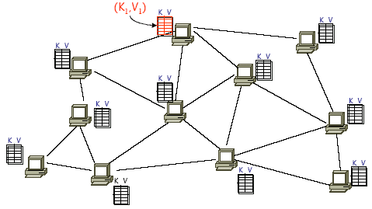
DHT: API (4)

Slide 52
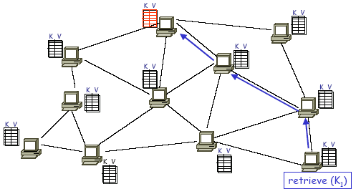
DHT: API (5)

Slide 53
Usage of DHT
File sharing and backup [CFS, Ivy, OceanStore, PAST, Pastiche …]
Web cache and replica [Squirrel, Croquet Media Player]
Censor-resistant stores [Eternity]
DB query and indexing [PIER, Place Lab, VPN Index]
Event notification [Scribe]
Naming systems [ChordDNS, Twine, INS, HIP]
Communication primitives [I3, …]
Host mobility [DTN Tetherless Architecture]
Used as a basic block of Amazon dynamo

Slide 54
DHT Design Pattern
Map key to a space
Each node owns a sub space
Routing table follows the effective distributed routing search guideline

Slide 55
CAN
Abstraction
map a key to a “point” in a multi-dimensional Cartesian space
a node “owns” a zone in the overall space
route from one “point” to another

Slide 56
CAN Example: Two Dimensional Space
Space divided among nodes
Each node covers either a square or a rectangular area of ratios 1:2 or 2:1
1

Slide 57
CAN Example: Two Dimensional Space
Space divided among nodes
Each node covers either a square or a rectangular area of ratios 1:2 or 2:1
1
2

Slide 58
CAN Example: Two Dimensional Space
Space divided among nodes
Each node covers either a square or a rectangular area of ratios 1:2 or 2:1
3
1
2

Slide 59
CAN Example: Two Dimensional Space
Space divided among nodes
Each node covers either a square or a rectangular area of ratios 1:2 or 2:1
3
1
2
4

Slide 60
CAN Example: Two Dimensional Space
Space divided among nodes
Each node covers either a square or a rectangular area of ratios 1:2 or 2:1

Slide 61
CAN Insert: Example (1)
node I::insert(K,V)
I

Slide 62
CAN Insert: Example (2)
node I::insert(K,V)
(1) a = h_{x}(K)
b = h_{y}(K)
I
y = b
x = a
Example: Key=“Matrix3” h(Key)=60

Slide 63
CAN Insert: Example (3)
node I::insert(K,V)
(1) a = h_{x}(K)
b = h_{y}(K)
(2) route(K,V) -> (a,b)
I
y = b
x = a

Slide 64
CAN Insert: Routing
A node maintains state only for its immediate neighboring nodes
Forward to neighbor which is closest to the target point
a type of greedy, local routing scheme

Slide 65
CAN Insert: Example (4)
node I::insert(K,V)
(1) a = h_{x}(K)
b = h_{y}(K)
(2) route(K,V) -> (a,b)
(3) (K,V) is stored at (a,b)
I
y = b
x = a

Slide 66
CAN Retrieve: Example
node J::retrieve(K)
J

Slide 67
CAN Retrieve: Example
node J::retrieve(K)
(1) a = h_{x}(K)
b = h_{y}(K)
(2) route “retrieve(K)” to (a,b)
y = b
J
x = a

Slide 68
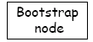
CAN Insert: Join (1)
2) pick a random
point (p,q) in space
J
new node
1) Discover some node “J” already in CAN

Slide 69
CAN Insert: Join (2)
N
J
new node
3) J routes to (p,q), discovers node N

Slide 70
CAN Insert: Join (3)
Inserting a new node affects only a single other node and its
immediate neighbors
N
new node
J
4) split N’s zone in half… new node owns one half

Slide 71
CAN Evaluations
Guarantee to find an item if in the network
Load balancing
hashing achieves some load balancing
overloaded node replicates popular entries at neighbors
Scalability
for a uniform (regularly) partitioned space with n nodes and d dimensions
storage:
per node, number of neighbors is 2d
routing
average routing path is (dn^{1/d})/3 hops (due to Manhattan distance routing, expected hops in each dimension is dimension length * 1/3)
a fixed d can scale the network without increasing per-node state

Slide 72
Chord
Space is a ring
Consistent hashing: m bit identifier space for both keys and nodes
key identifier = SHA-1(key), where SHA-1() is a popular hash function,
Key=“Matrix3” → ID=60
node identifier = SHA-1(IP address)
IP=“198.10.10.1” → ID=123

Slide 73
Chord: Storage using a Ring
K125, K5, K10
IP=“198.10.10.1”
N10
N123
K11, K20
Circular
7-bit ID Space
N32
K101
N90
N55
K60
Key=“Matrix 3”
A key is stored at its successor: node with next higher or equal ID

Slide 74
Exercise
Compare impact of load balancing when adding a new machine, for two content mapping approaches,
Each machine has an index 0-m-1, hash function mapping content to 0-m-1, and assign to corresponding machine
Chord mapping

Slide 75
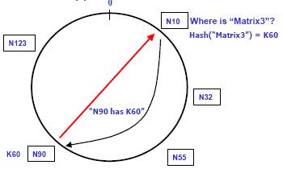
How to Search: One Extreme
Every node knows of every other node
Routing tables are large O(N)
Lookups are fast O(1)

Slide 76
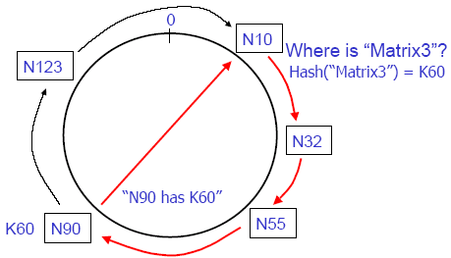
How to Search: the Other Extreme
Every node knows its successor in the ring
If follow the distributed routing search principle, what the routing table may look like?
Routing tables are small O(1)
Lookups are slow O(N)

Slide 77
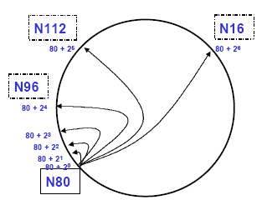
Chord Solution: “finger tables”
Node K knows the node that is maintaining K + 2^{i}, where K is mapped id of current node
increase distance exponentially
K+32
K+64
K+16
K+8
K+4
K+2
K+1
N80

Slide 78
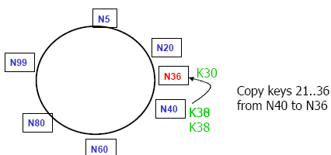
Joining the Ring
use a contact node to obtain info
transfer keys from successor node to new node
updating fingers of existing nodes

Slide 79
DHT: Chord Node Join
Assume an identifier space [0..8]
Node n1 joins
Succ. Table
0
i id+2^{i} succ
0 2 1
1 3 1
2 5 1
7
1
6
2
5
3
4

Slide 80
DHT: Chord Node Join
Node n2 joins
Succ. Table
0
i id+2^{i} succ
0 2 2
1 3 1
2 5 1
7
1
6
2
Succ. Table
5
3
i id+2^{i} succ
0 3 1
1 4 1
2 6 1
4

Slide 81
DHT: Chord Node Join
Node n6 joins
Succ. Table
0
i id+2^{i} succ
0 2 2
1 3 6
2 5 6
7
1
Succ. Table
i id+2^{i} succ
0 7 1
1 0 1
2 2 2
6
2
Succ. Table
5
3
i id+2^{i} succ
0 3 6
1 4 6
2 6 6
4

Slide 82
DHT: Chord Node Join
Node n0 starts join
Succ. Table
0
i id+2^{i} succ
0 2 2
1 3 6
2 5 6
7
1
Succ. Table
i id+2^{i} succ
0 7 1
1 0 1
2 2 2
6
2
Succ. Table
5
3
i id+2^{i} succ
0 3 6
1 4 6
2 6 6
4

Slide 83
DHT: Chord Node Join
Succ. Table
i id+2^{i} succ
0 1 1
1 2 2
2 4 6
After Nodes n0 joins
Succ. Table
0
i id+2^{i} succ
0 2 2
1 3 6
2 5 6
7
1
Succ. Table
i id+2^{i} succ
0 7 0
1 0 0
2 2 2
6
2
Succ. Table
5
3
i id+2^{i} succ
0 3 6
1 4 6
2 6 6
4

Slide 84
DHT: Chord Insert Items
Succ. Table
Items
Nodes: n1, n2, n0, n6
Items: f7, f1
i id+2^{i} succ
0 1 1
1 2 2
2 4 0
7
0
Succ. Table
Items
7
1
i id+2^{i} succ
0 2 2
1 3 6
2 5 6
1
Succ. Table
6
2
i id+2^{i} succ
0 7 0
1 0 0
2 2 2
Succ. Table
5
3
i id+2^{i} succ
0 3 6
1 4 6
2 6 6
4

Slide 85
DHT: Chord Routing
Succ. Table
Items
Upon receiving a query for item id, a node:
checks whether stores the item locally
if not, forwards the query to the largest node in its successor table that does not exceed id
i id+2^{i} succ
0 1 1
1 2 2
2 4 0
7
0
Succ. Table
Items
7
1
i id+2^{i} succ
0 2 2
1 3 6
2 5 6
1
query(7)
Succ. Table
6
2
i id+2^{i} succ
0 7 0
1 0 0
2 2 2
Succ. Table
5
3
i id+2^{i} succ
0 3 6
1 4 6
2 6 6
4

Slide 86
DHT (CAN, Chord) Summary
Each node “owns” some portion of the key-space
in CAN, it is a multi-dimensional “zone”
in Chord, it is the key-id-space between two nodes in 1-D ring
Files and nodes are assigned random locations in key-space
provides some load balancing
probabilistically equal division of keys to nodes
Distributed, greedy routing based alg
node X does not know of a path to a key Z
but if it appears that node Y is the closest to Z among all of the nodes known to X
so route to Y

Slide 87
Backup Slides

Slide 88
Outline
Admin and recap
Application overlays (distributed network applications) to
scale bandwidth/resource (BitTorrent)
distribute content lookup (Freenet, DHT)
distribute content verification (Block chain)
Notes:
https://bitcoin.org/bitcoin.pdf

Slide 89
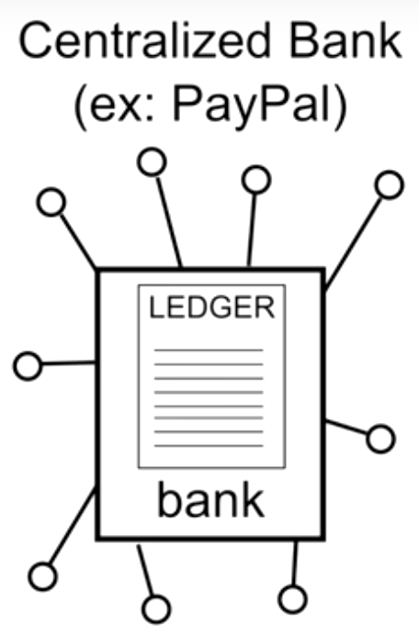
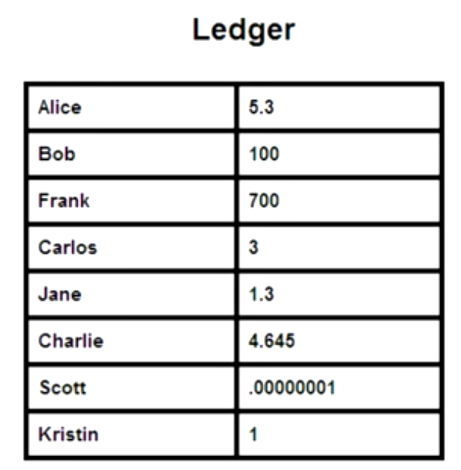
Motivation: Centralized Clearing House of Financial Transactions
Function:
sees all transactions
with its centralized ledger
be able to verify validity of each transaction, e.g., no double-spending
Problem
single point of trust (attack, charge)
Source: https://www.slideshare.net/JrmeKehrli/the-blockchain-the-technology-behind-bitcoin

Slide 90
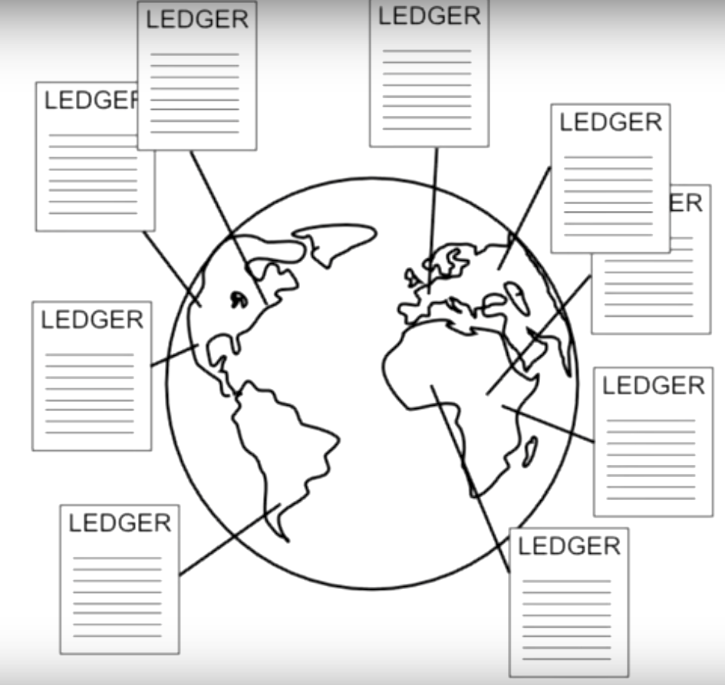
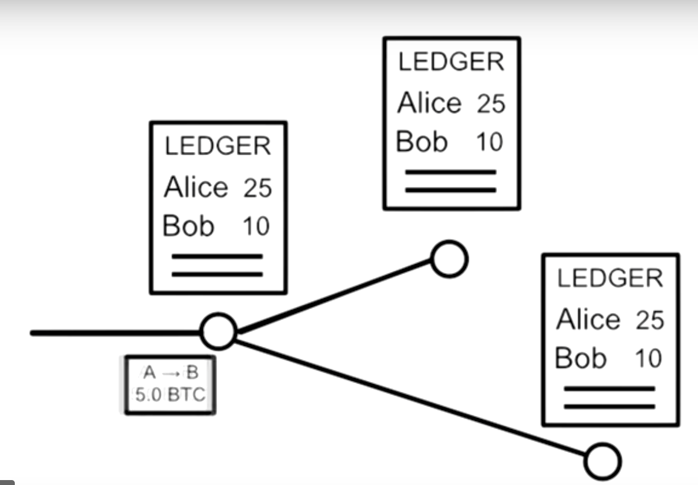

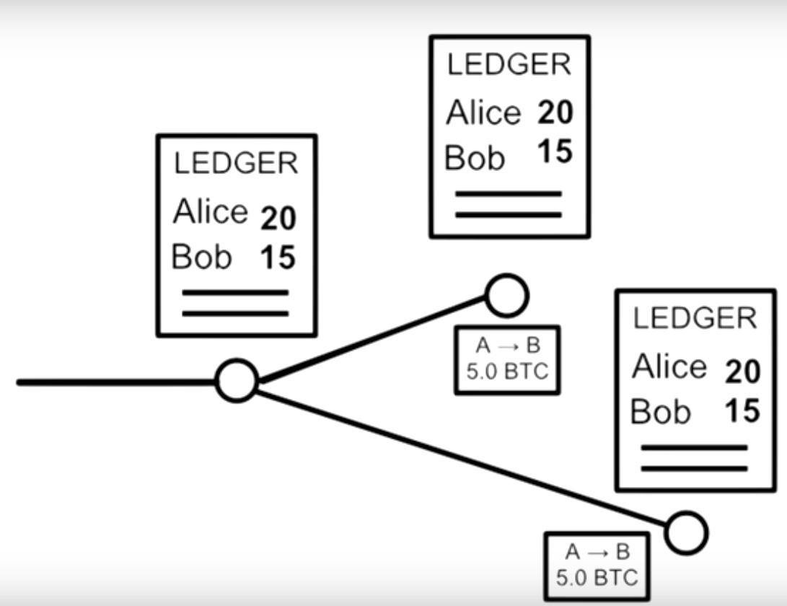
Motivation: Distributed Ledgers

Slide 91
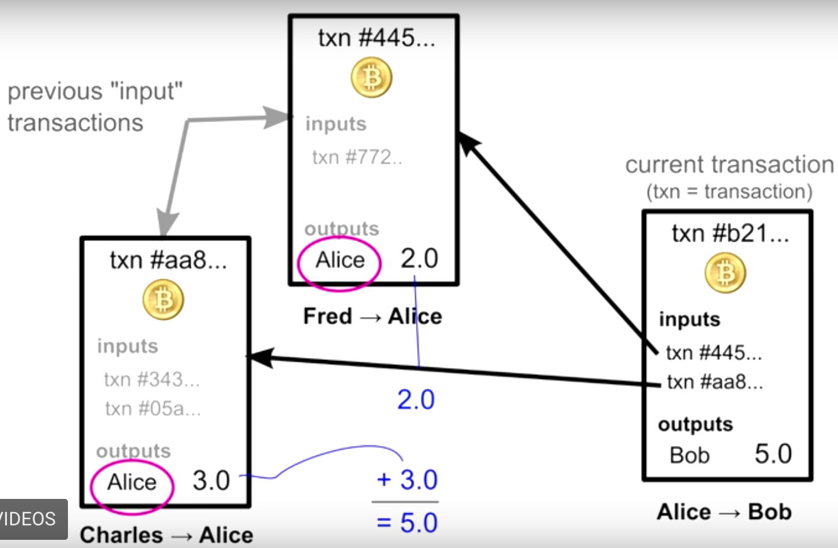
BitCoin Details: Transaction Chains

Slide 92
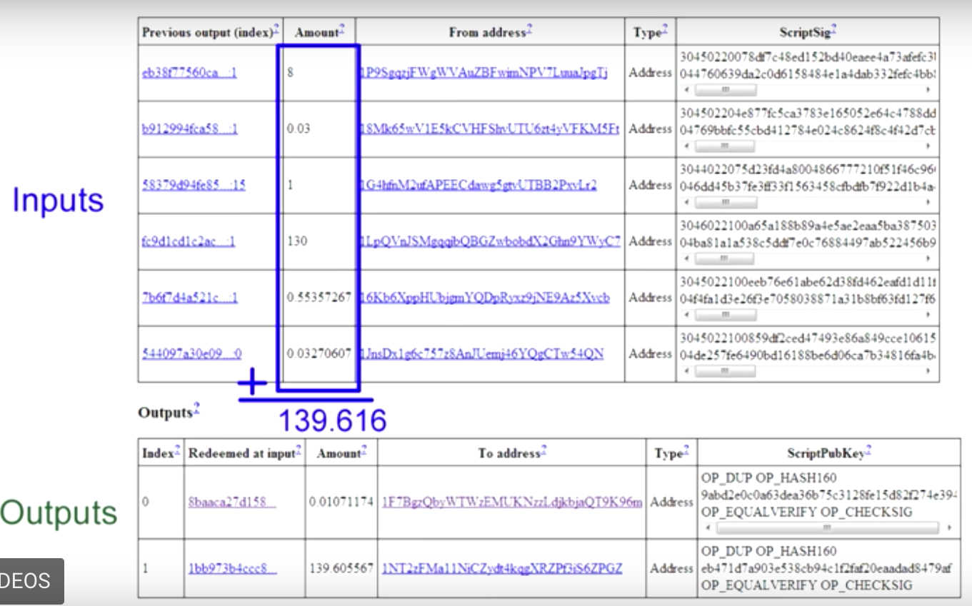
BitCoin Details: Transaction Chains

Slide 93
Motivation
Main problem
Avoid faked entries of ledgers

Slide 94
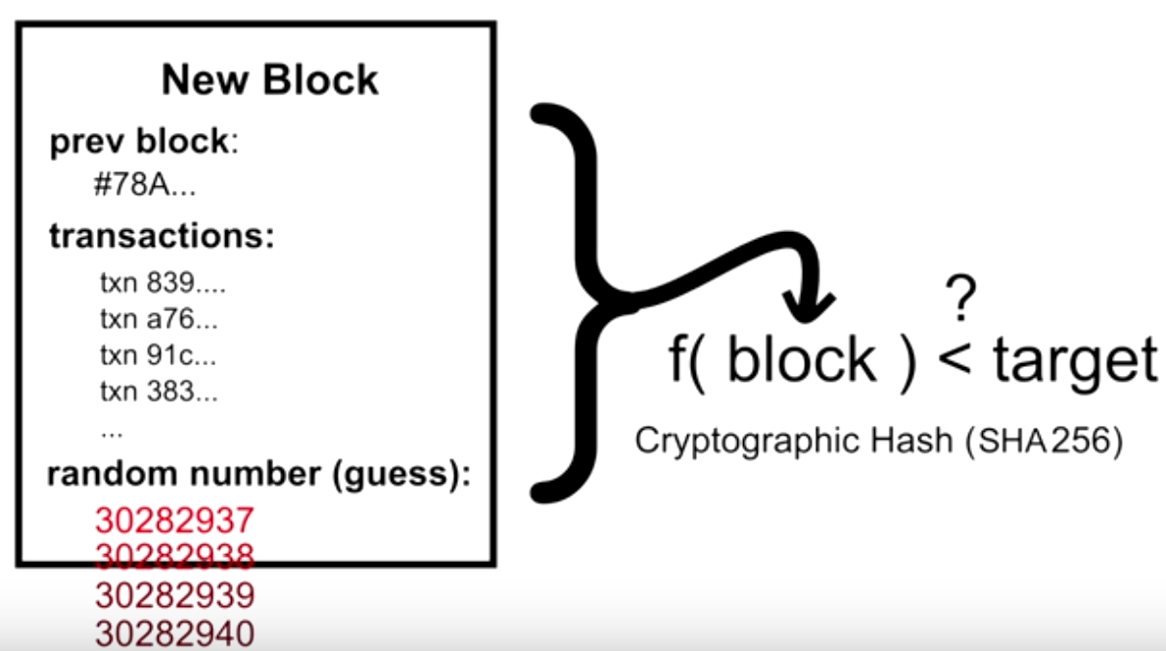
Block Chain: Basic Ideas
Make each entry difficult to create: Block Puzzle

Slide 95
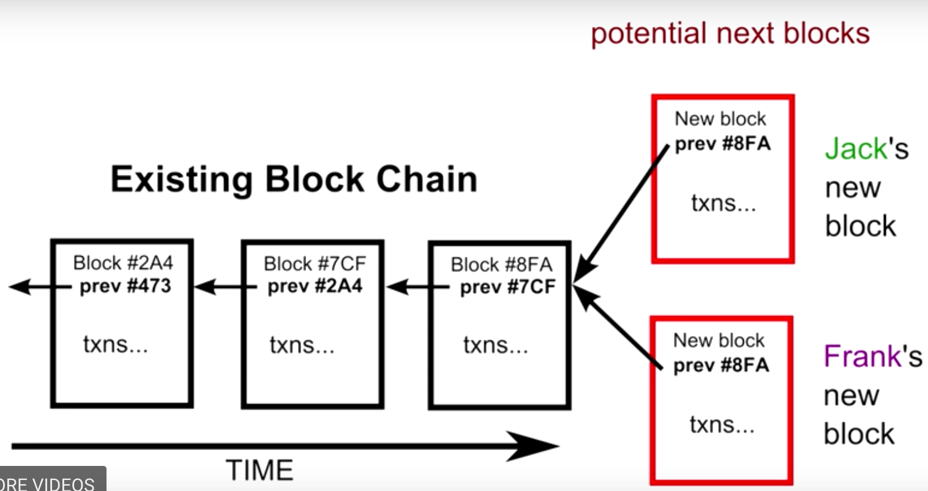
Block Chain: Basic Ideas
Chain the blocks to make any creation of a new block needs to re-do all work

Slide 96
Outline
Admin and recap
Application overlays (distributed network applications) to
scale bandwidth/resource (BitTorrent)
distribute content lookup (Freenet, DHT)
distribute content verification (Block chain)
Notes:
https://bitcoin.org/bitcoin.pdf

Slide 97
Outline
Admin and recap
Application overlays (distributed network applications) to
scale bandwidth/resource (BitTorrent)
distribute content lookup (Freenet, DHT)
achieve anonymity (Tor)

Slide 98
Problem
Internet surveillance like traffic analysis reveals users privacy
Encryption does not hide packet headers, which still reveal a great deal about users
End-to-end anonymity is needed
Solution: distributed, anonymous networks

Slide 99
Example: Tor Networks
Basic idea
Overlay network using Onion Routers (OR)
Onion routing so that each onion router knows only the previous and next hop
https://torstatus.blutmagie.de/

Slide 100
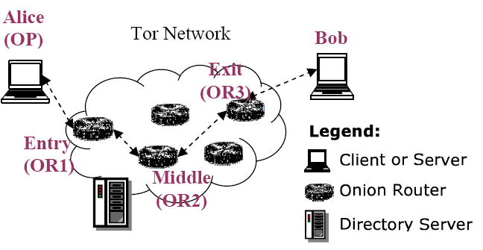

Tor Components
Client: the user of the Tor network
Server: the target TCP applications such as web servers
Tor (onion) router: the special proxy relays the application data
Directory server: servers holding Tor router information

Slide 101
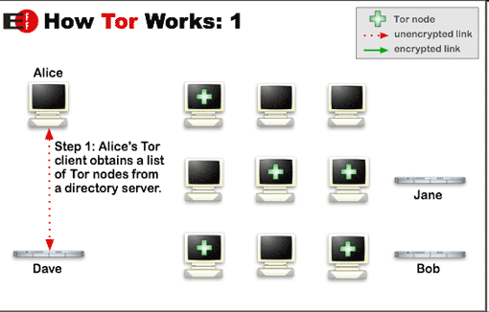
Tor Steps

Slide 102
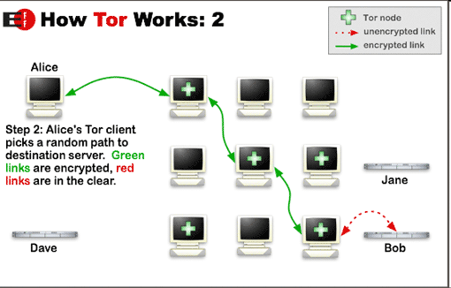
Tor Steps

Slide 103
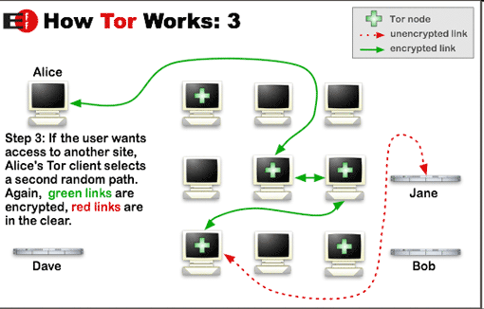
Tor Steps

Slide 104
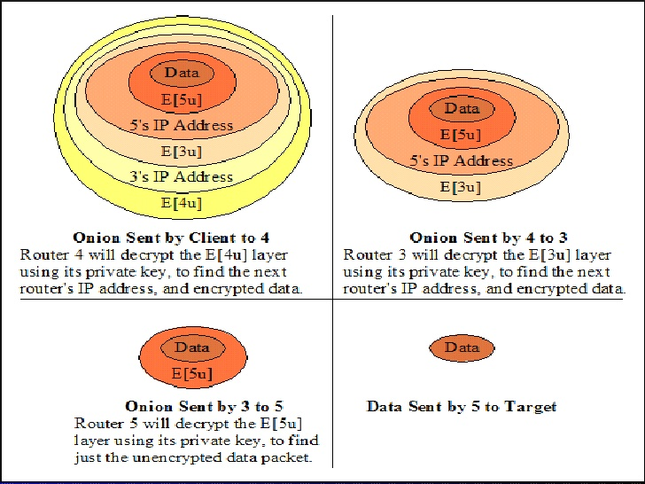
Tor Networks
Onions using public key
Basic idea
Overlay network using Onion Routers (OR)

Slide 105

Tor Optimization: Symmetric Key
Alice
Bob
C2
√
M
M
OR2
C3
M
M
C1
OR1
OR3
A circuit is built incrementally one hop by one hop
Onion-like encryption
Alice negotiates an AES key with each router
Messages are divided into equal sized cells
Each router knows only its predecessor and successor
Only the Exit router (OR3) can see the message

Slide 106
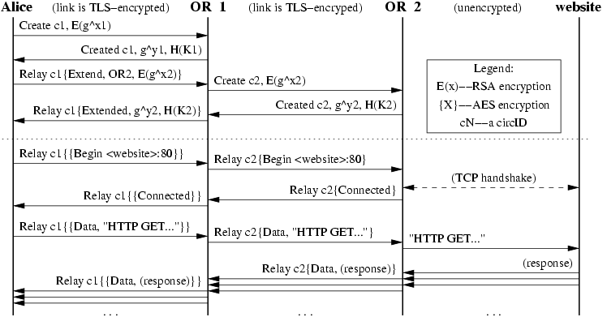
Example Tor Commands

Slide 107
Tor Location-Hidden Service
Goal: allow one to offer a TCP service without revealing his IP address
Access Control: filtering incoming requests
Robustness: maintaining a long-term pseudonymous identity
Smear-resistance: against socially disapproved acts

Slide 108
Tor Location-Hidden Service: Creating and Connecting to a Location Hidden Service
Notes:
Rendezvous Points in Tor
User 1 generates a long-term public key pair to identify his service.
User 1 chooses some introduction points, and advertises them on the lookup service, signing the advertisement with his public key.
User 1 builds a circuit to each of his introduction points, and tells them to wait for requests.
User 2 learns about User 1 ’s service out of band (perhaps via lookup service If user 2 wants to access User 1 ’s service anonymously, she must connect via Tor to the lookup serivce.
User 2 chooses an OR as the rendezvous point for her connection to user 1’s service. She builds a circuit to the RP, and gives it a randomly chosen “rendezvous cookie” to recognize user 1.
User 2 opens an anonymous stream to one of user 1’s introduction points, and gives it a message (encrypted with User 1’s public key) telling the RP and rendezvous cookie, and the start of a DH handshake. The introduction point then sends the message to user 1.
If User 1 wants to talk to user 2 he builds a circuit to user 2’s RP and sends the rendezvous cookie, the second of half of the DH handshake, and a hash of the session key they now share. By the same argument, this enables user 2 of knowing she shares the key only with user 1.
The RP connects user 2’s circuit to user 1’s. at this point the RP can’t recognize user 2, user 1, or the data they transmit.
User 2 sends a relay begin cell along the circuit. It arrives at user 1’s OP, which connects to user 1’s web server.
An anonymous stream has been established, and user 2 and user 1 can now communicate as normal.

Slide 109
Backup Slides

Slide 110

Strawman: Central Index: Publish (based on Napster)
insert(X,
123.2.21.23)
...
Publish
I have X, Y, and Z!
123.2.21.23

Slide 111
Central Index: Search
123.2.0.18
search(A)
-->
123.2.0.18
124.1.0.1
Query
Reply
124.1.0.1
Where is file A?

Slide 112
Central Index: Ping
123.2.0.18
ping
124.1.0.1
ping

Slide 113
Central Index: Fetch
123.2.0.18
124.1.0.1
fetch

Slide 114
Napster Messages
General Packet Format
[chunksize] [chunkinfo] [data...]
CHUNKSIZE:
Intel-endian 16-bit integer
size of [data...] in bytes
CHUNKINFO: (hex)
Intel-endian 16-bit integer.
00 - login rejected
02 - login requested
03 - login accepted
0D - challenge? (nuprin1715)
2D - added to hotlist
2E - browse error (user isn't online!)
2F - user offline
5B - whois query
5C - whois result
5D - whois: user is offline!
69 - list all channels
6A - channel info
90 - join channel
91 - leave channel
…..

Slide 115
Centralized Index
Advantages
simplicity, easy to implement sophisticated search engines (boolean exp) on top of the index system
Disadvantages
lack of robustness, scalability: central search server single point of bottleneck/failure
easy to take down !

